Slide 1


HORIZONE SRT TOOL
Proponent: Mark GIDION ENOJADO

Slide 2

INTRODUCTION
Main Objective
Increase site accuracy score.
Reduce blatant errors.
Improve the wellbeing of the reviewers

Slide 3

Situation
Not hitting the ACCURACY Target Goal
Knowledge Issue
Grey Area
Blatant Errors
Possible reasons
Loss of focus - Didn’t review Tagging Tree
Speeding - Scanning
Long jobs

Slide 4

TASK
Score Card
Accuracy Score
Goal is 90%
Reduce the blatant errors

Slide 5
ACTION
To design, develop and implement a tool that will help reviewers to reduce their blatant errors.
Google Extensions
Horizone SRT Tool
To design, develop and implement additional components that will improve the wellbeing of the reviewers
Text to Speech
Auto Tagging Tree
Sticky Tagging Tree
Timer with Logger

Slide 6
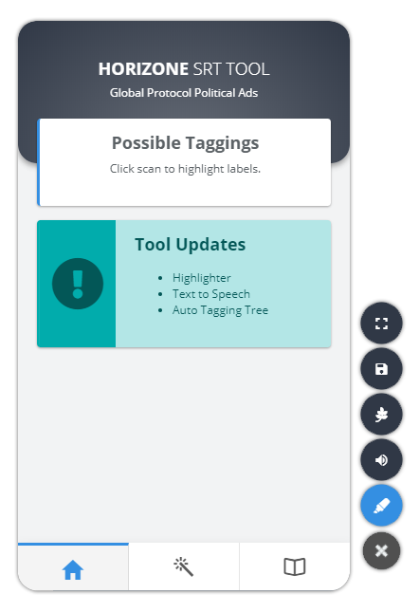
Software development cycle
SDLC - is a process which defines the various stages involved in the development of software for delivering a high-quality product
Requirement Gathering & Analysis
Design
Implementation and Coding
Testing
Deployment
Maintenance

Slide 7

Requirements
Google Chrome
Google Developer Account
Internet Connection
Programming Application
Database Application

Slide 8
HORIZONE SRT TOOL
THANK YOU ☺
Any Questions?

